Slide 1

Coding Workshop
Getting started
26.01.2026
Melissa Franke

Slide 2

So you want to code…
What you will need:
A Problem
A Solution Idea
The right tools for the job
  Language: Python
  IDE: VS Code
  Programming environment: virtual environment
  Package manager: pip
  Version control: GitHub
Coding Workshop
Getting Started
Melissa Franke
M.Sc
1

Slide 3
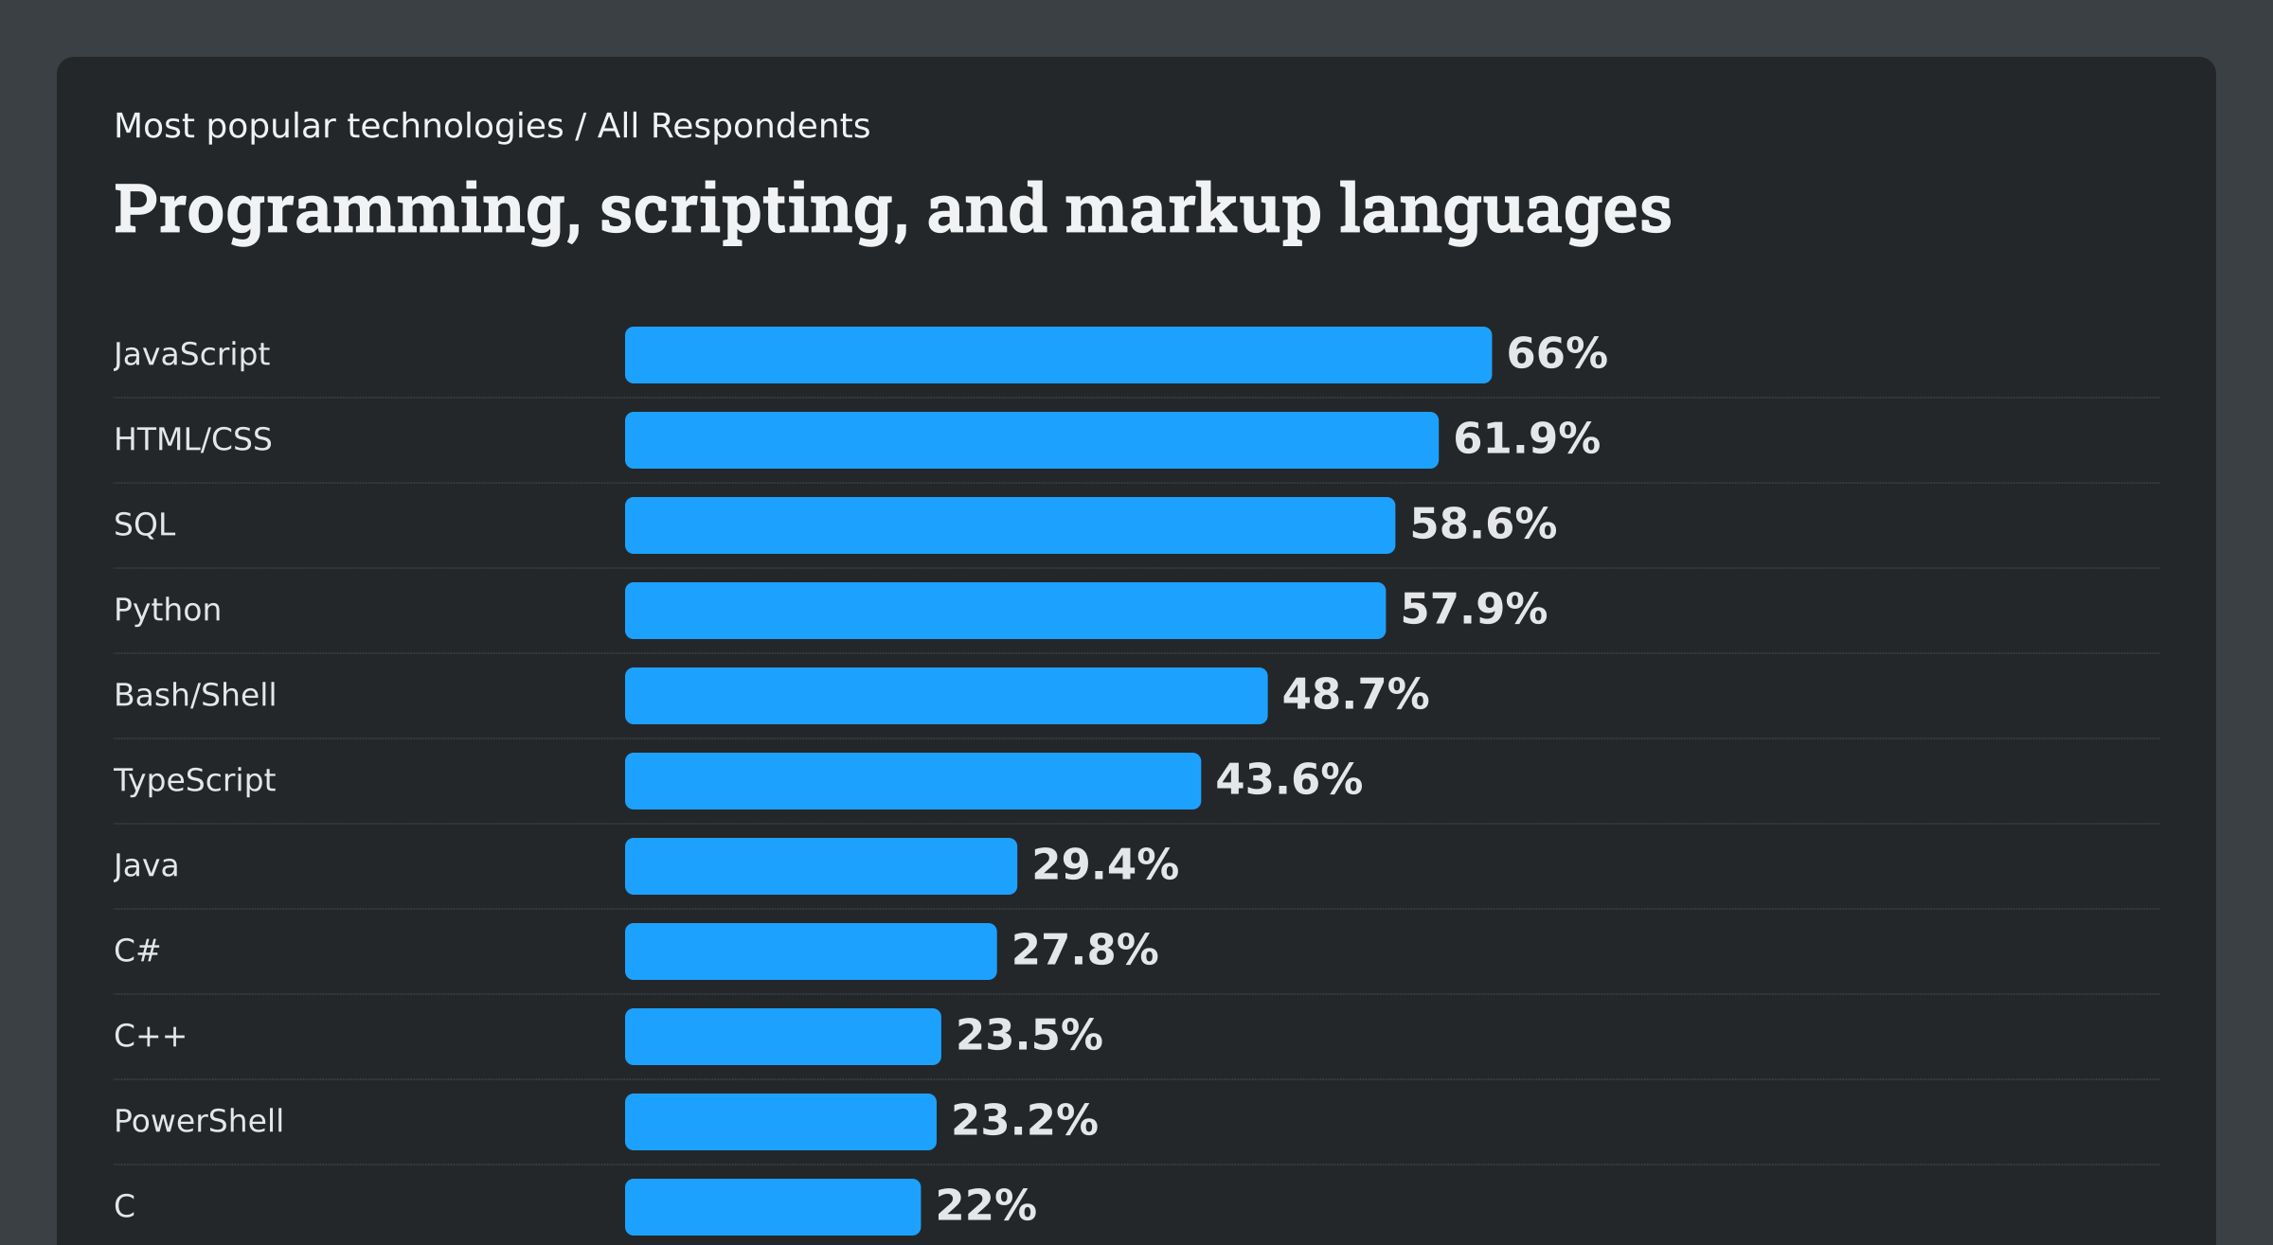
Programming Languages
Coding Workshop
Getting Started
Melissa Franke
M.Sc
1
Notes:
JavaScript, typescript, HTML/CSS -> Web
SQL -> Databanks
Python
Bash -> Human-Machine-Interfaces
Java -> Object Oriented
C, C++, C# -> universal, mostly applications on unix systems
Powershell -> Microsoft Scriptlanguage

Slide 4
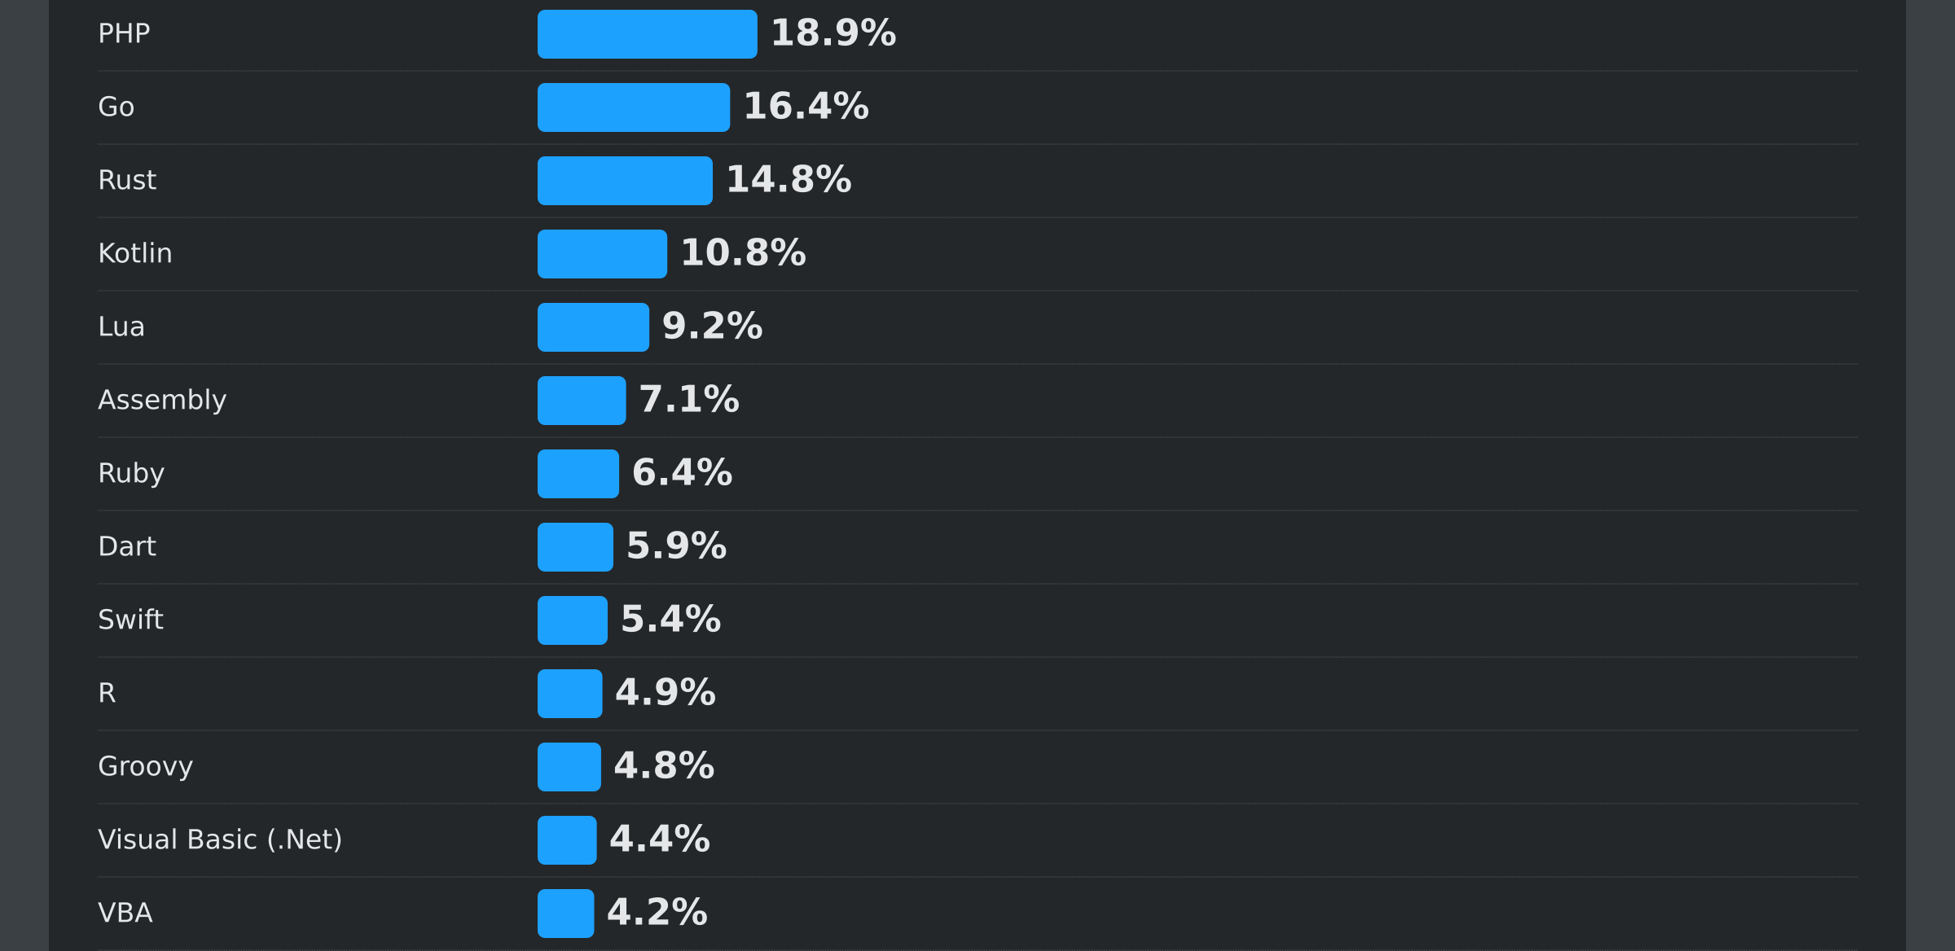
Programming Languages
Coding Workshop
Getting Started
Melissa Franke
M.Sc
1
Notes:
Lua: old, useable similar to an API
Swift: Apple language
Visual basic: Microsoft

Slide 5
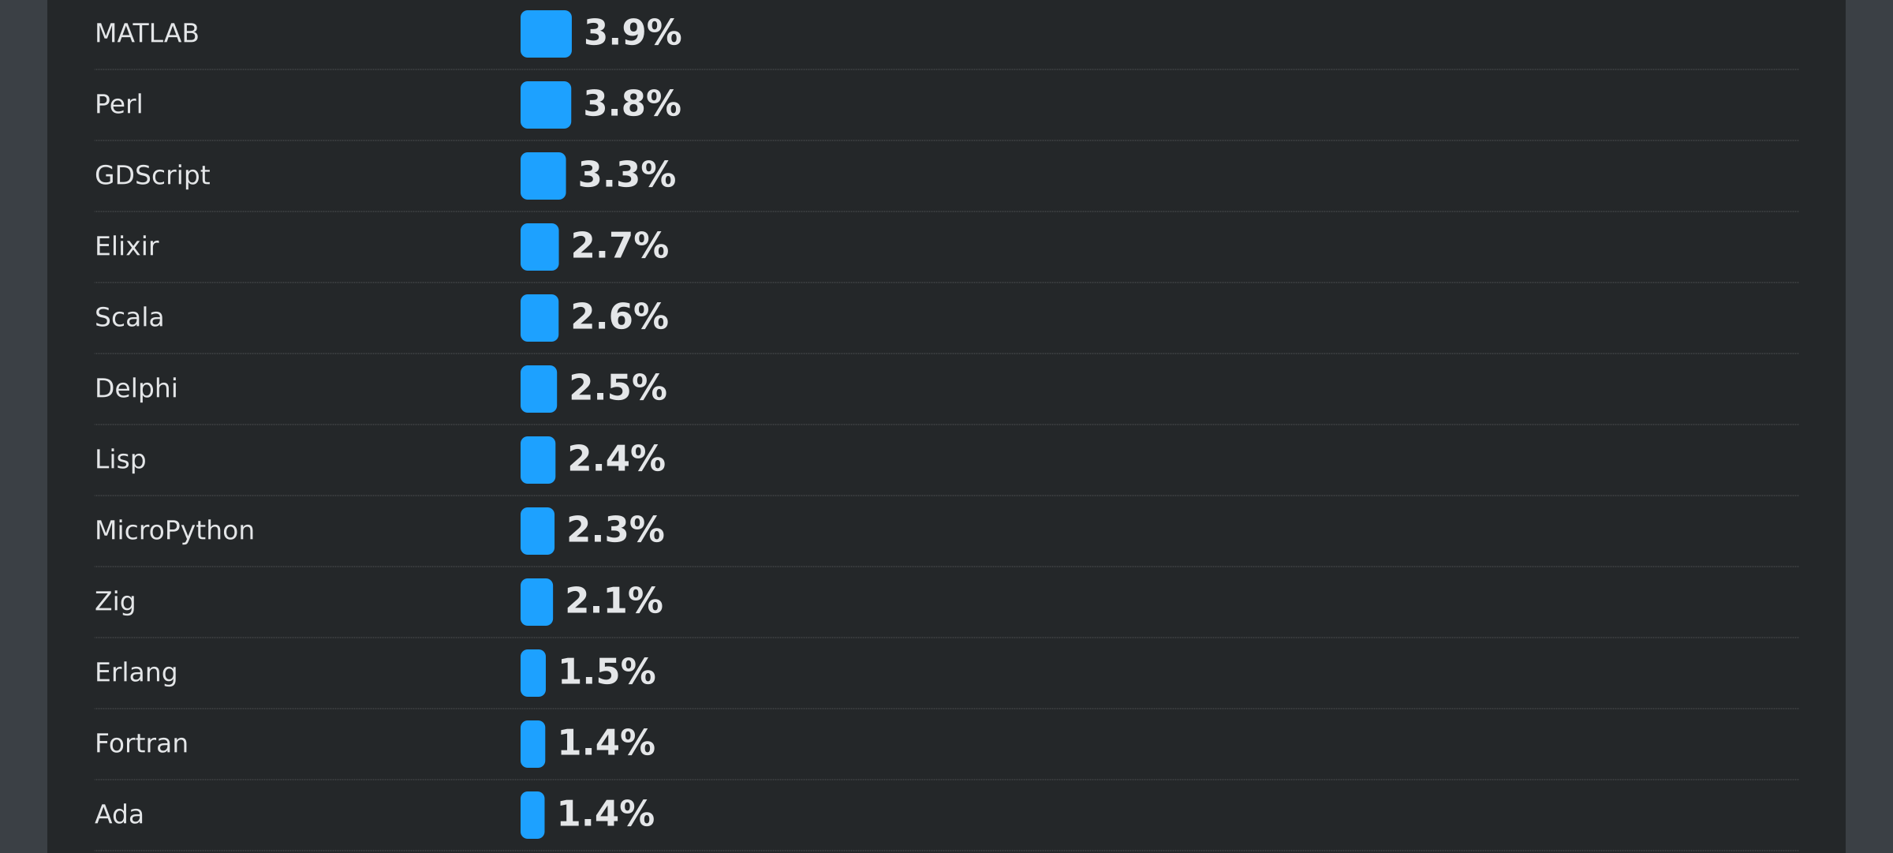
Programming Languages
Coding Workshop
Getting Started
Melissa Franke
M.Sc
1
Notes:
Perl -> Bioinformatics, Systemadministration
Delphi -> DIE/Language for Object Pascal
Fortran -> first real language for science

Slide 6
Programming Languages
Hundreds of programming languages
Which one do I use?
  Purpose of the language
  Context of the problem
  Personal preference
  Experience
  …
Coding Workshop
Getting Started
Melissa Franke
M.Sc
1

Slide 7
IDE
Integrated Development Environment
Comes with helpful tools to code like
  Debuggers
  text completion
  Sometimes integrated documentation
  Sometimes preinstalled packages
  Compilers, interpreters
Technically not needed to write code, but far easier
VSCode, MatLab, Anaconda, …
Coding Workshop
Getting Started
Melissa Franke
M.Sc
1

Slide 8
Environment
Isolated, self-contained directory for software projects
Contains:
  interpreters
  libraries
“Room for your work with all the tools you need”
Coding Workshop
Getting Started
Melissa Franke
M.Sc
1
Notes:
Immunos: Histo, nicht 2P
Also: Jerome‘s SP5 runs on Win7, because Programs need it, so he cannot open the files on a different setup

Slide 9
Package Manager
Streamlines handling software packages
Handles:
  Installation
  Actualisation
  Configuration
  Deinstallation
  …
Coding Workshop
Getting Started
Melissa Franke
M.Sc
1

Slide 10
Version Control
Supervisor on any changes made in your code
Allows:
  Documentation of changes
  Recovery of older versions
  Archiving
  Collaboration
  …
Coding Workshop
Getting Started
Melissa Franke
M.Sc
1

Slide 11
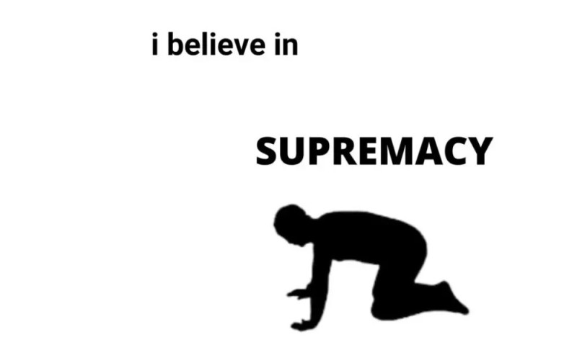

Version Control - Git
Linus Torvalds‘ milestones:
  Linux
  Git
Project folder
  Pull from or push to
  Commits
  Branches
  Automated Merges or Merge conflicts
Coding Workshop
Getting Started
Melissa Franke
M.Sc
1

Slide 12
Questions?

